Slide 1
C++ Workshop
Day 15 :(

Slide 2
OOP Concepts
Data encapsulation
Abstraction
Inheritance
Polymorphism

Slide 3
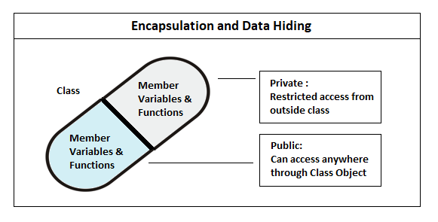
Data encapsulation
Data encapsulation, also known as data hiding, is the mechanism whereby the implementation details of a class are kept hidden from the user. The user can only perform a restricted set of operations on the hidden members of the class by executing special functions commonly called methods.

Slide 4
Data abstraction
Data abstraction is one of the most essential and important feature of object oriented programming in C++. Abstraction means displaying only essential information and hiding the details. Data abstraction refers to providing only essential information about the data to the outside world, hiding the background details or implementation.
Consider a real life example of a man driving a car. The man only knows that pressing the accelerators will increase the speed of car or applying brakes will stop the car but he does not know about how on pressing accelerator the speed is actually increasing, he does not know about the inner mechanism of the car or the implementation of accelerator, brakes etc in the car. This is what abstraction is.

Slide 5
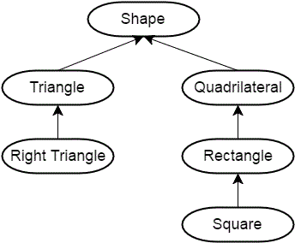
Inheritance
The capability of a class to derive properties and characteristics from another class is called Inheritance. The derived class inherits all the features from the base class and can have additional features of its own.

Slide 6
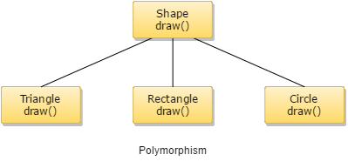
Polymorphism
Polymorphism means "many forms", and it occurs when we have many classes that are related to each other by inheritance.

